Slide 1

Lecture 11: Menus, popups & custom controls
WRPV301: Advanced Programming
Dr Simone Beets

Slide 2
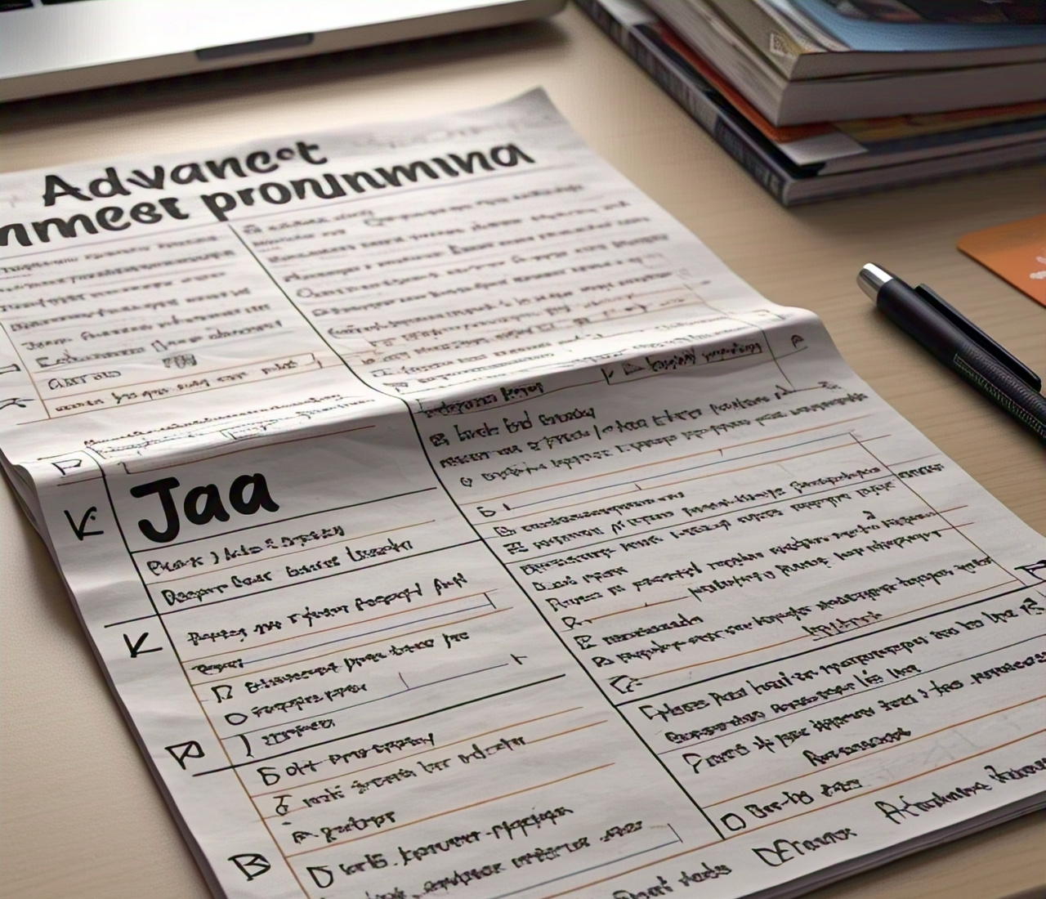
Upcoming test
Will set the test this week
If changes, will confirm
About 30% theory, 10% applied answers, 60% practical
Need to prep all content after XML, including today’s work
Cheat sheet only allowed for practical section
3 hours
Start at 09:00, Saturday 16 May 2026, Labs 3 & 4
Notes:
Test 1 marks – just received
Concession?
Code vs SceneBuilder – SceneBuilder not for this test

Slide 3

Menus & different types
Popups & tooltips
Custom controls & animations
Overview

Slide 4

Menus

Slide 5
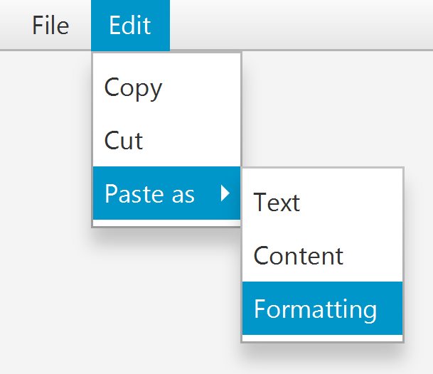
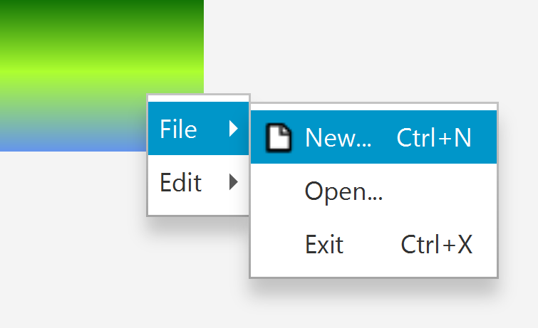
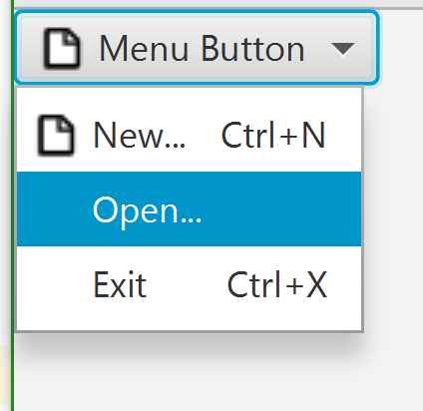
Menus
Menu Bar
Context Menu
Menu Button
Strip that displays menus at the top of the stage (typically)
Button that displays a menu when clicked on, i.e., a multi-action button
Popup menu that appears when right-click a control
Different context menu appears for different controls

Slide 6
Naming conventions
“…” after name, e.g., “New…”, implies that a dialogue will appear when selected
Nothing after the name, e.g., “Close Project”, implies action will take place immediately
Name is typically “verb [object]”
e.g., “New…”, “Import Settings…”, “Cut”, etc.
Unless the menu to which the option belongs is a verb, then the menu item may only be an object, e.g., “View → Recent Documents”

Slide 7
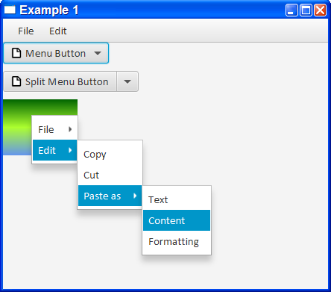
Menus /Example01
Constructing menu structure similar for all types of menus
What attached to (root) makes biggest difference
If using image resources, must mark folder as “resources”

Slide 8

Popups

Slide 9
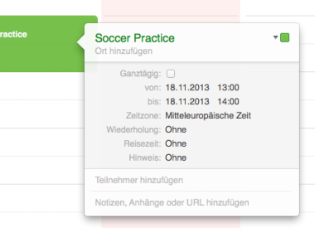
Popups
Sometimes, we want additional information but not using a separate stage
Popup
Node that appears on top of all the nodes in a scene
Does not get affected by the current layouts, i.e., moving stages does not necessarily move the popup

Slide 10
Popups
Can create custom Popups
The popup is not a modal, i.e., can still interact with the rest of the application
User interaction
When creating a custom control, consider what the user will do to interact with it & the sequence
E.g., what happens when mouse over, left/right mouse down/up, etc.

Slide 11



Mouse dragging behaviour
screen
mouse move
mouse button down (left)
drag mouse (move while button down)
mouse button released (left)
mouse move
dragging

Slide 12
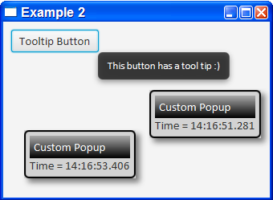
Popups /Example02
Button
View Tooltip when mouse hovers over button
Creates a custom Popup when button clicked
Custom Popup
Has custom appearance
Made draggable on the screen
Is hidden when secondary mouse button clicked

Slide 13
Using the Anchor Point while Dragging
(getX,getY)
anchorY
anchorX
(event.getScreenX, event.getScreenY)

Slide 14

Custom controls

Slide 15
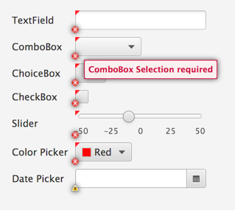
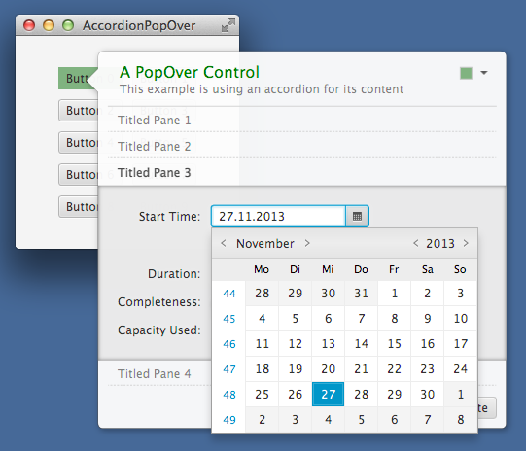

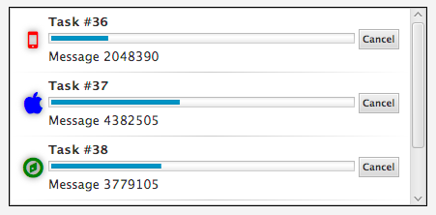
Custom controls
Often need a specific type of control, but one does not exist
Options
Search for existing packages for more controls, e.g., ControlsFX (http://fxexperience.com/controlsfx/)
Do without
Create own, e.g., CustomPopup

Slide 16
Custom controls
When creating a custom control
Find an existing control that has similar functionality
Subclass it & add/remove behaviour, change visuals
Decide if any properties you want to expose
Decide type of behavior that you would like

Slide 17
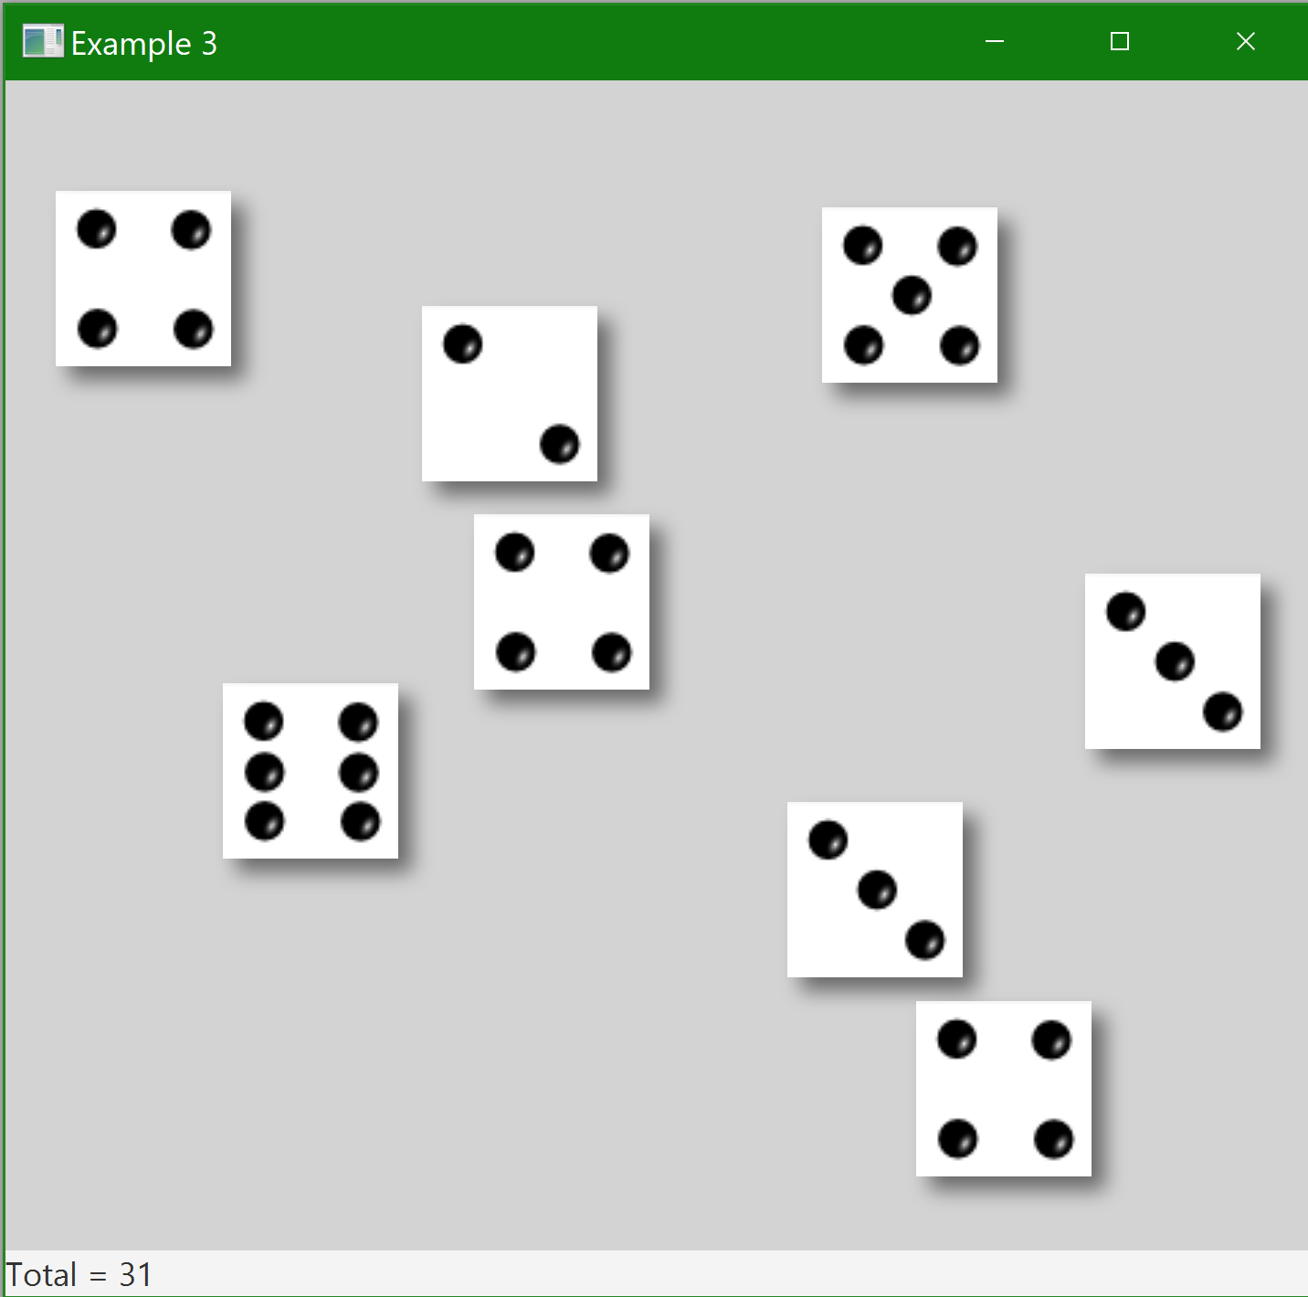
Custom Control Die /Example03
Want to create a board game X & need Dice that players can “roll”
Want a customised Die (plural Dice) class
Has a value, which should be a property that can be listened/bound to
Should display one of six images, one for each value
Should be able to drag Die around a container using the left-mouse button (primary)
Should be able to roll the Die by double-clicking on it
When roll or move the Die, some animation should play
Options for base classes: Many {Pane, Button, Popup, ImageView, …}
http://docs.oracle.com/javafx/2/animations/jfxpub-animations.htm

Slide 18
Custom Control Die /Example03
Value
Integer property that represents the number on the visible face of the die
Changing the value changes the image displayed
Dragging behaviour
Start of drag, while dragging, end of drag
Visually differ in different states
Double click behaviour
Plays a “rolling” animation & during animation, changes the image displayed (but not the value)
At end of animation: Chooses a random value between 1 and 6, & sets this as the new value (which also changes the image)

Slide 19
Playing Area /Example03
Has a lblTotal label whose text is bound to a sum number binding
Right-click behaviour
Adds a new Die whose centre is centred on the mouse cursor where the click occurred
When adding a new die, it binds its value to the sum number binding
Rolling any die on the Playing Area
Updates the sum number binding, which updates the lblTotal

